Slide 1


THYSSENKRUPP Project Task Submitted By
Jeelkumar Langalia

Slide 2
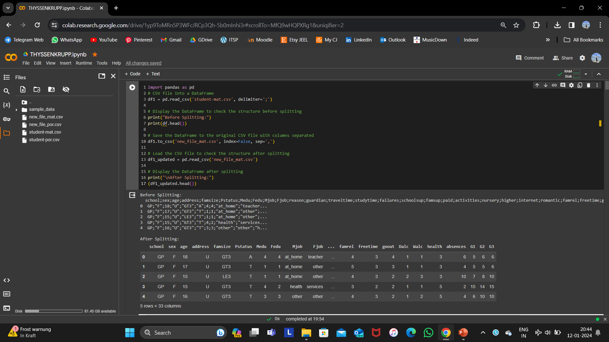
Upload the file and Organized the columns and named the new file new_file_mat.csv

Slide 3
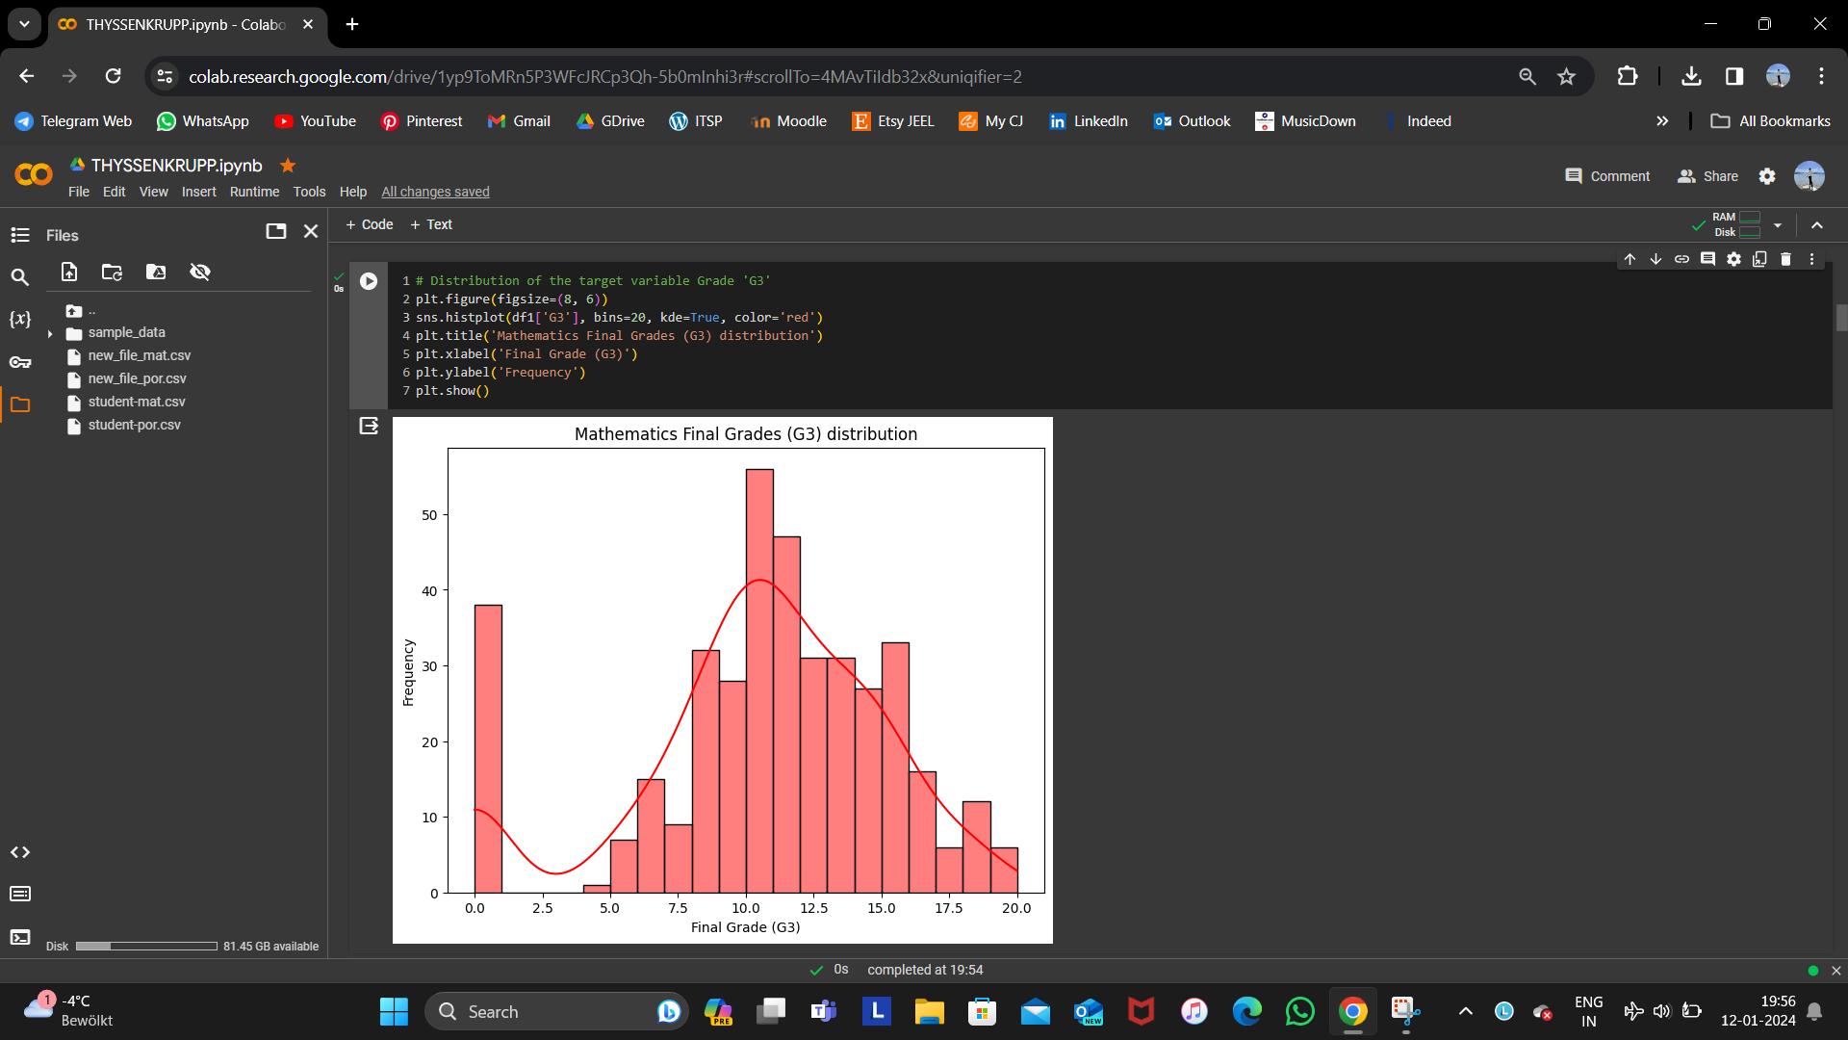
Result of the plot of Distribution of the target Variable Grade (G3) for Mathematics Dataset

Slide 4
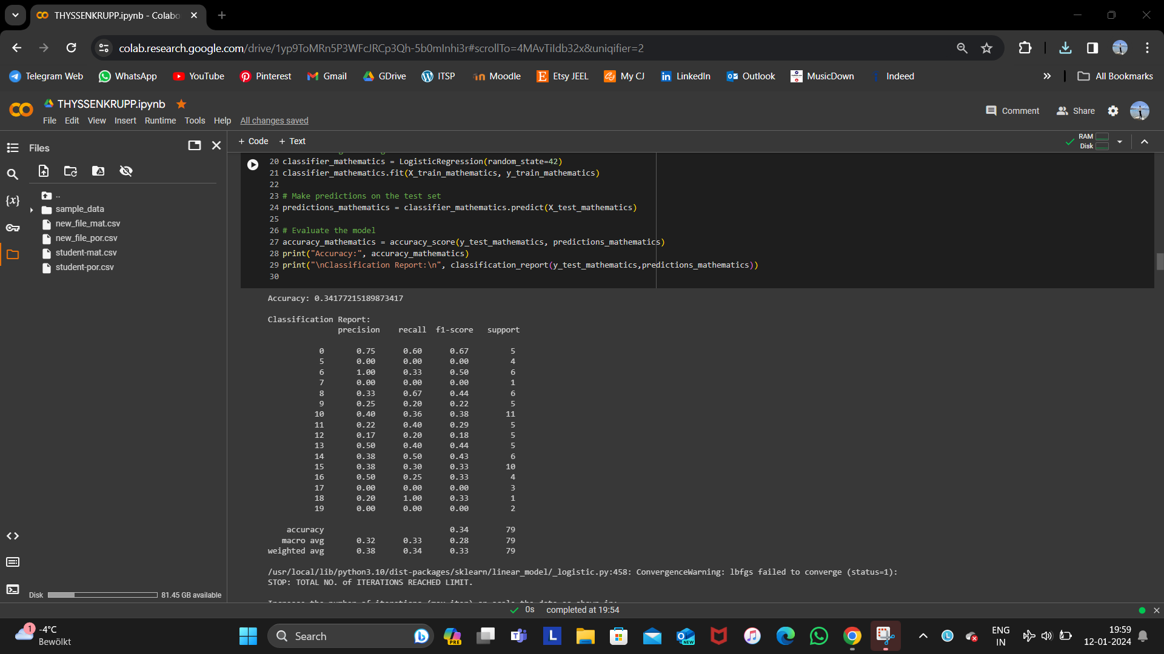
Accuracy of Classification of Mathematics dataset

Slide 5
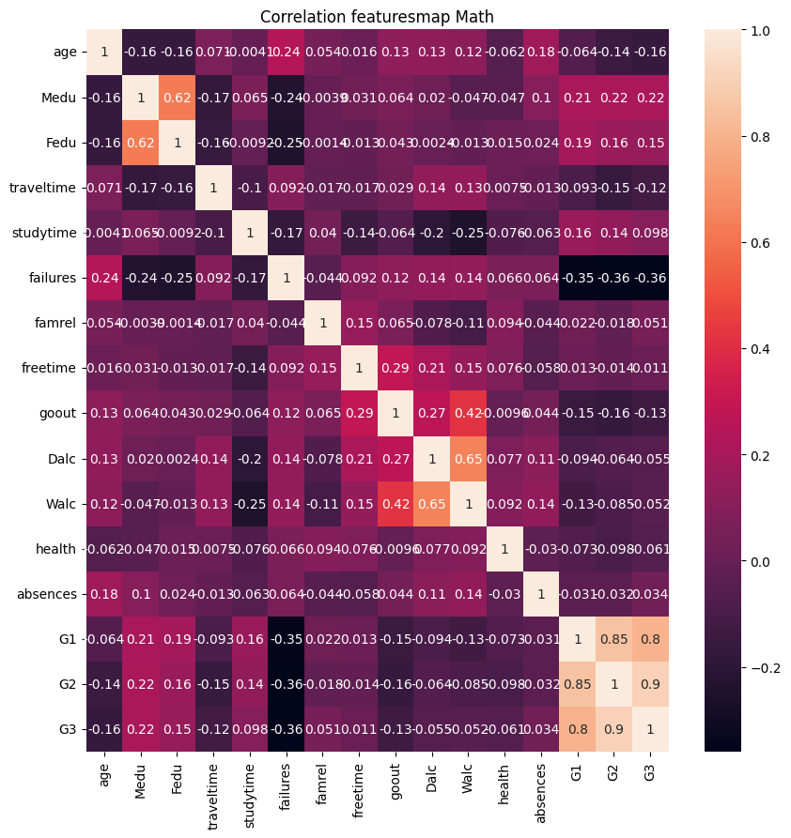
This is the correlation Features-map of Mathematics dataset, which shows the relationship between one feature and another feature.

Slide 6
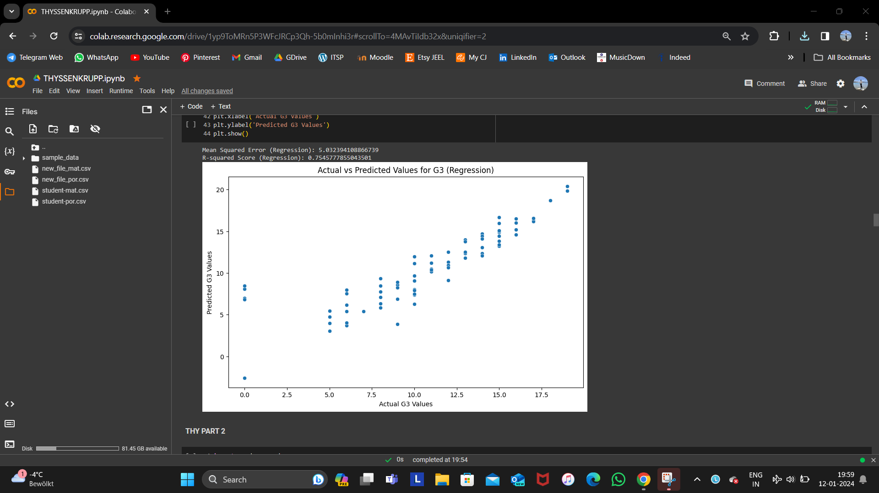
Result of Regression of Mathematics dataset

Slide 7
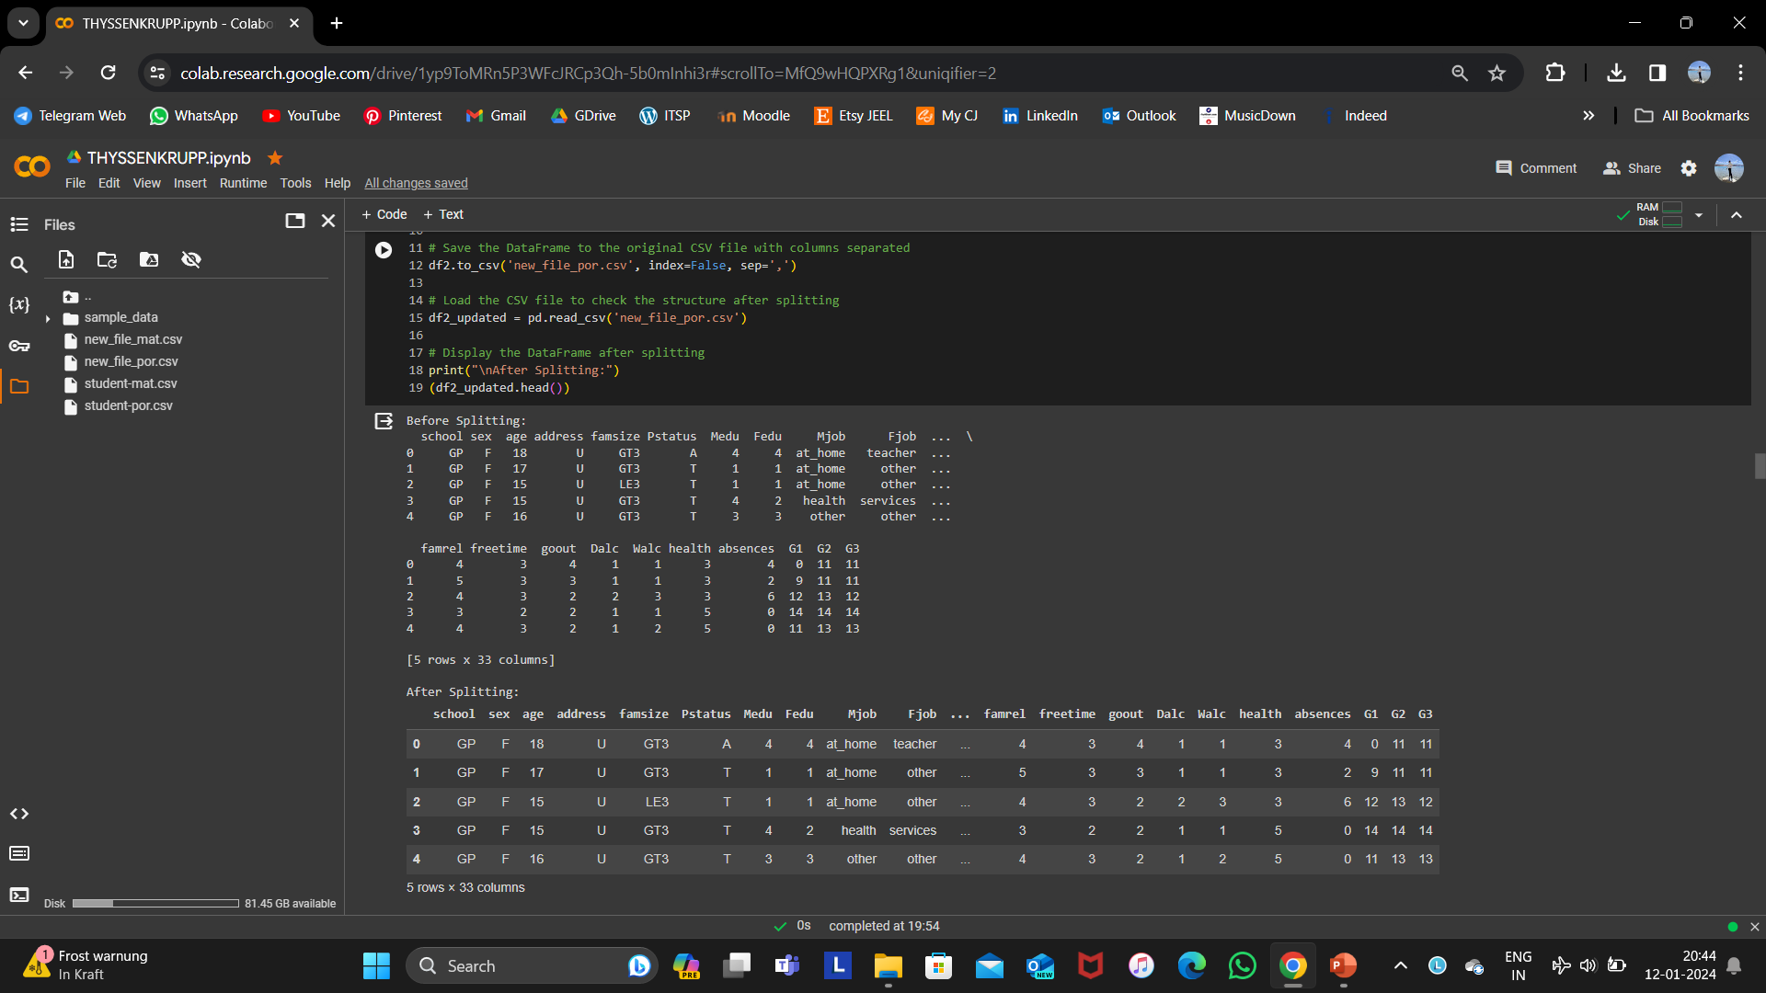
Upload the file and Organized the columns and named the new file new_file_por.csv

Slide 8
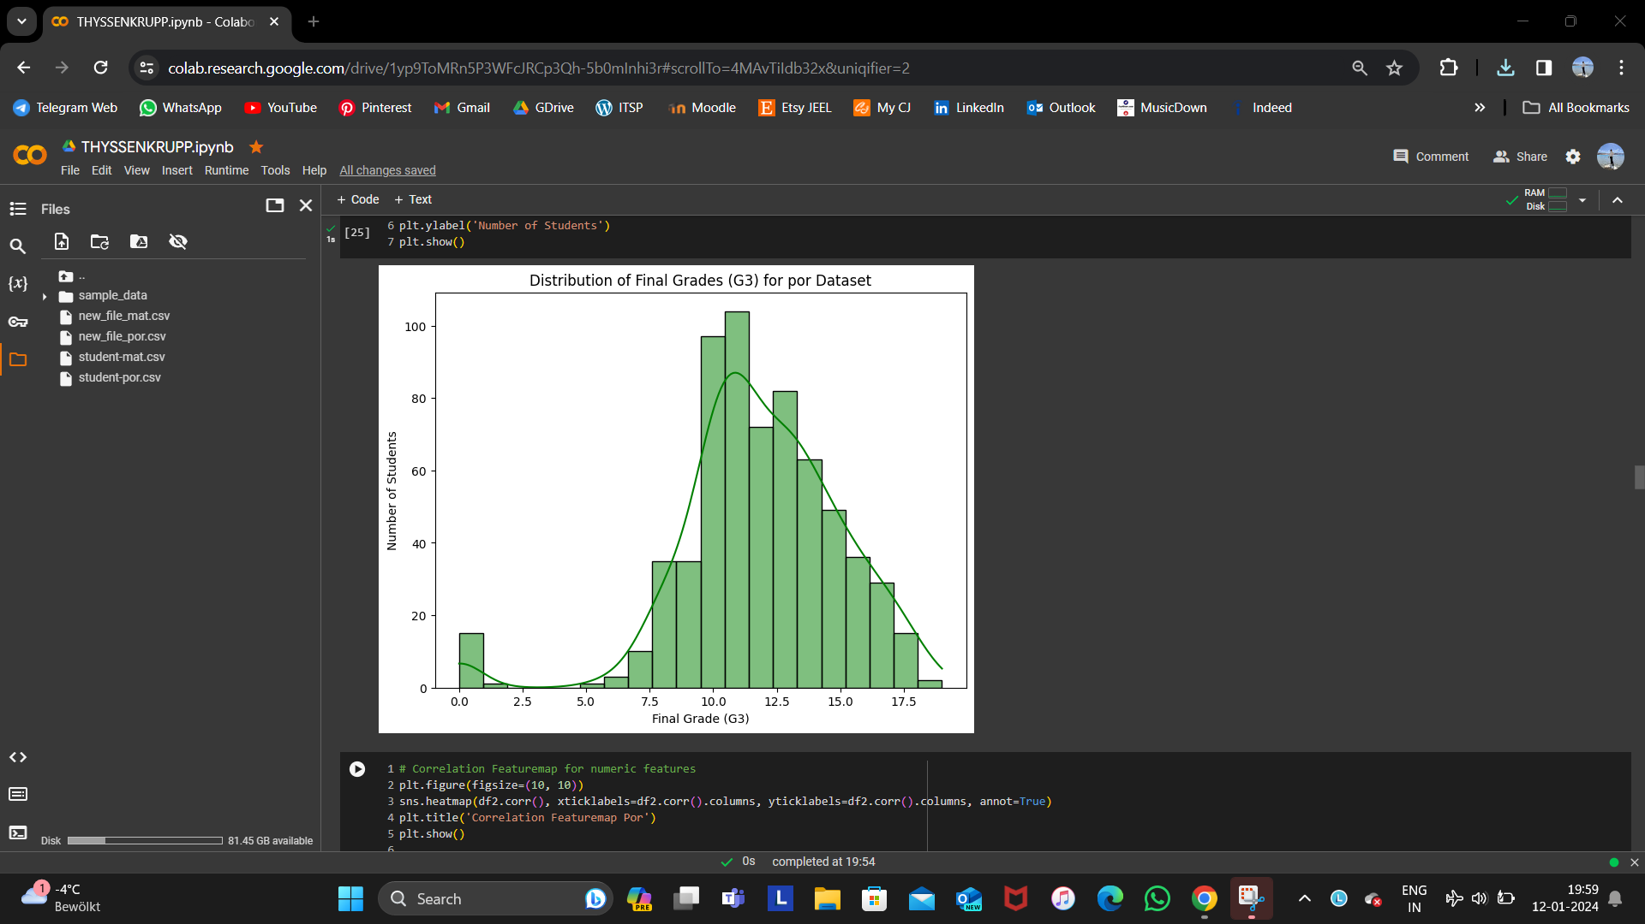
Result of the plot of Distribution of the target Variable Grade (G3) for Portuguese Dataset

Slide 9
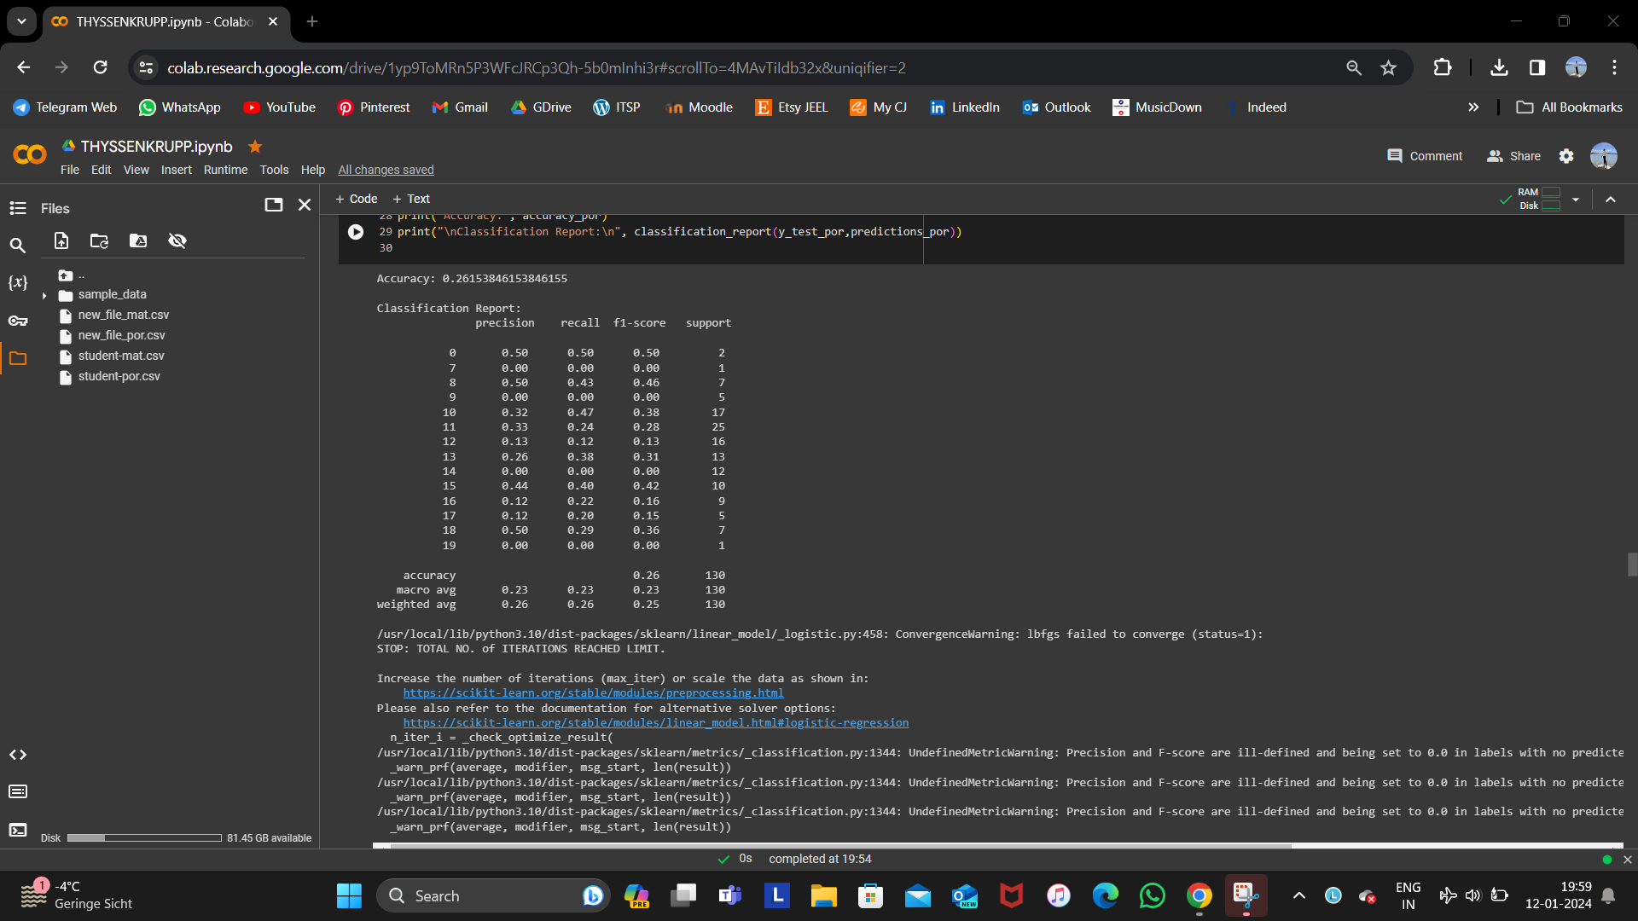
Accuracy of Classification of Portuguese dataset

Slide 10

This is the correlation Features-map of Portuguese dataset, which shows the relationship between one feature and another feature.

Slide 11
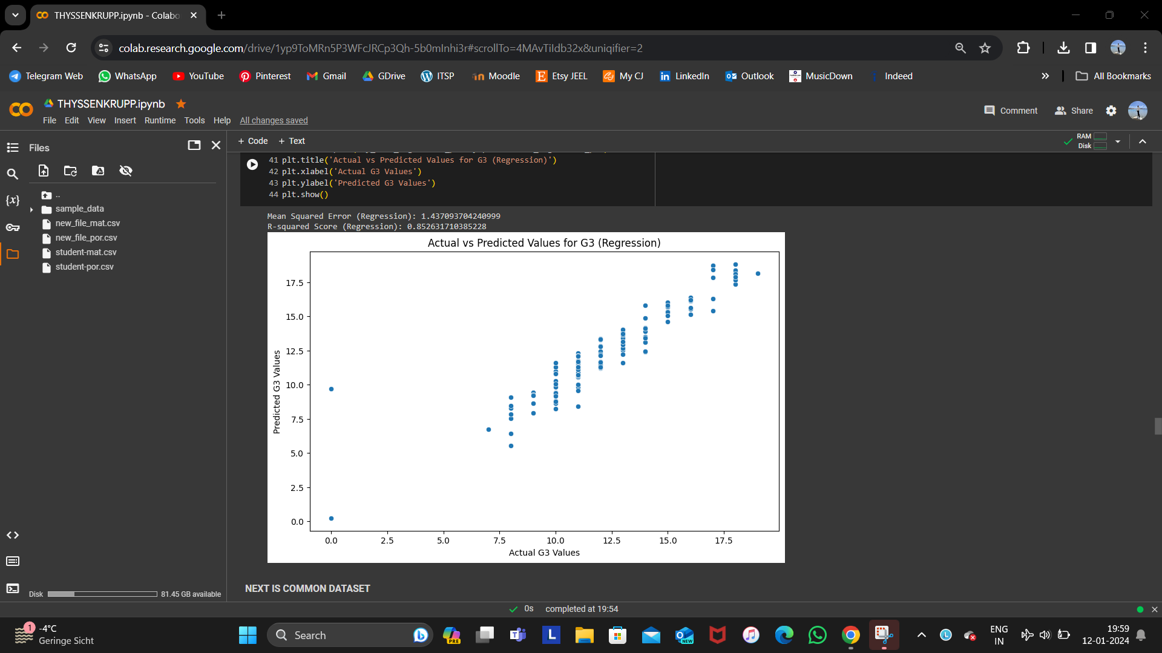
Result of Regression of Portuguese dataset

Slide 12
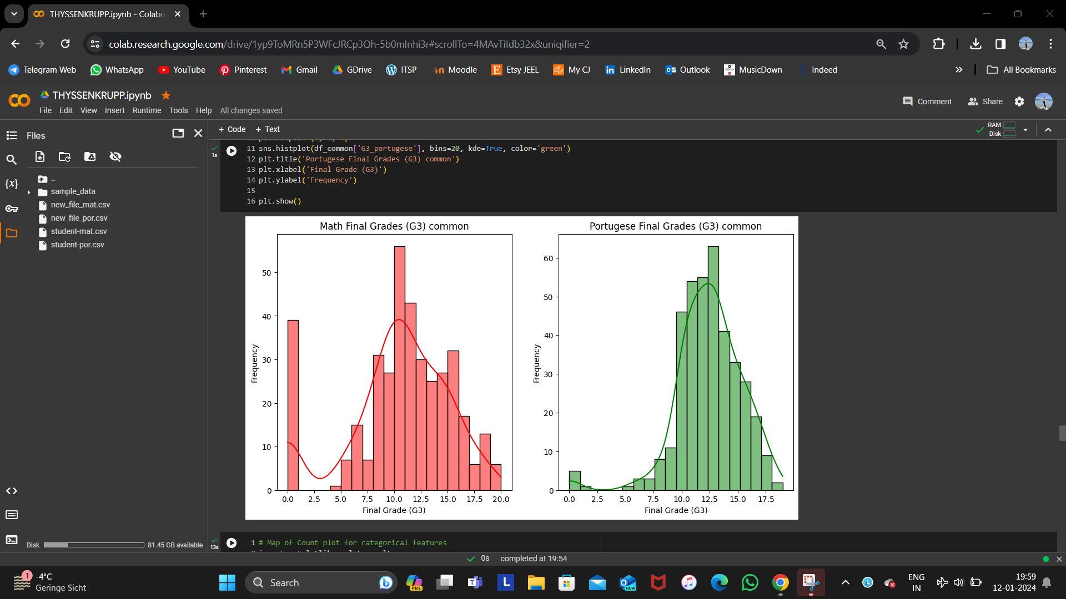
Result of the plot of Distribution of the target Variable Grade (G3) for Common Dataset

Slide 13
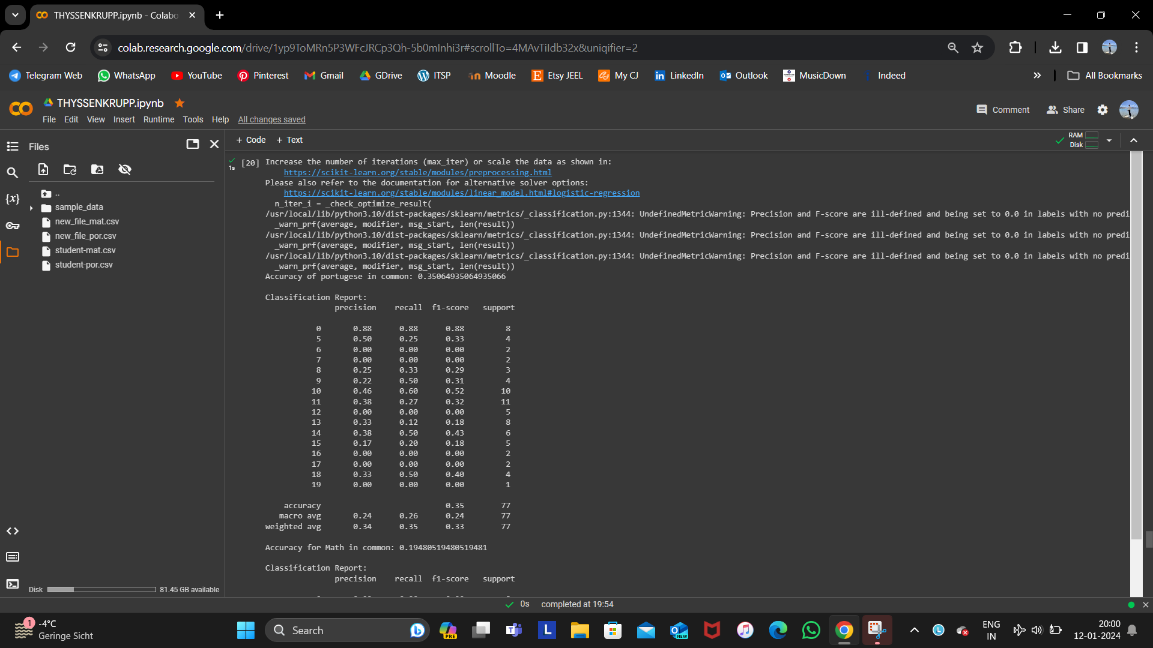
Accuracy of Classification of Common dataset

Slide 14
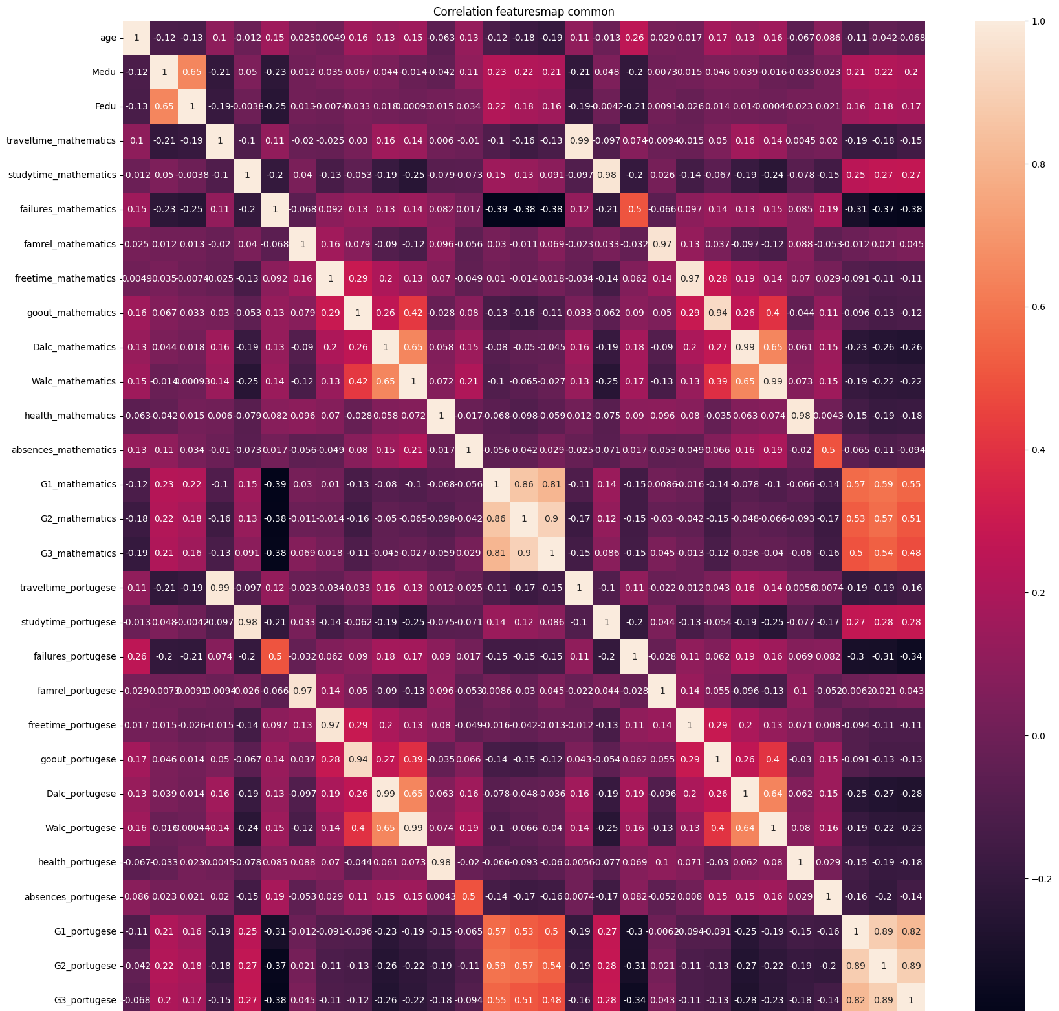
This is the correlation Features-map of Common dataset, which shows the relationship between one feature and another feature.

Slide 15
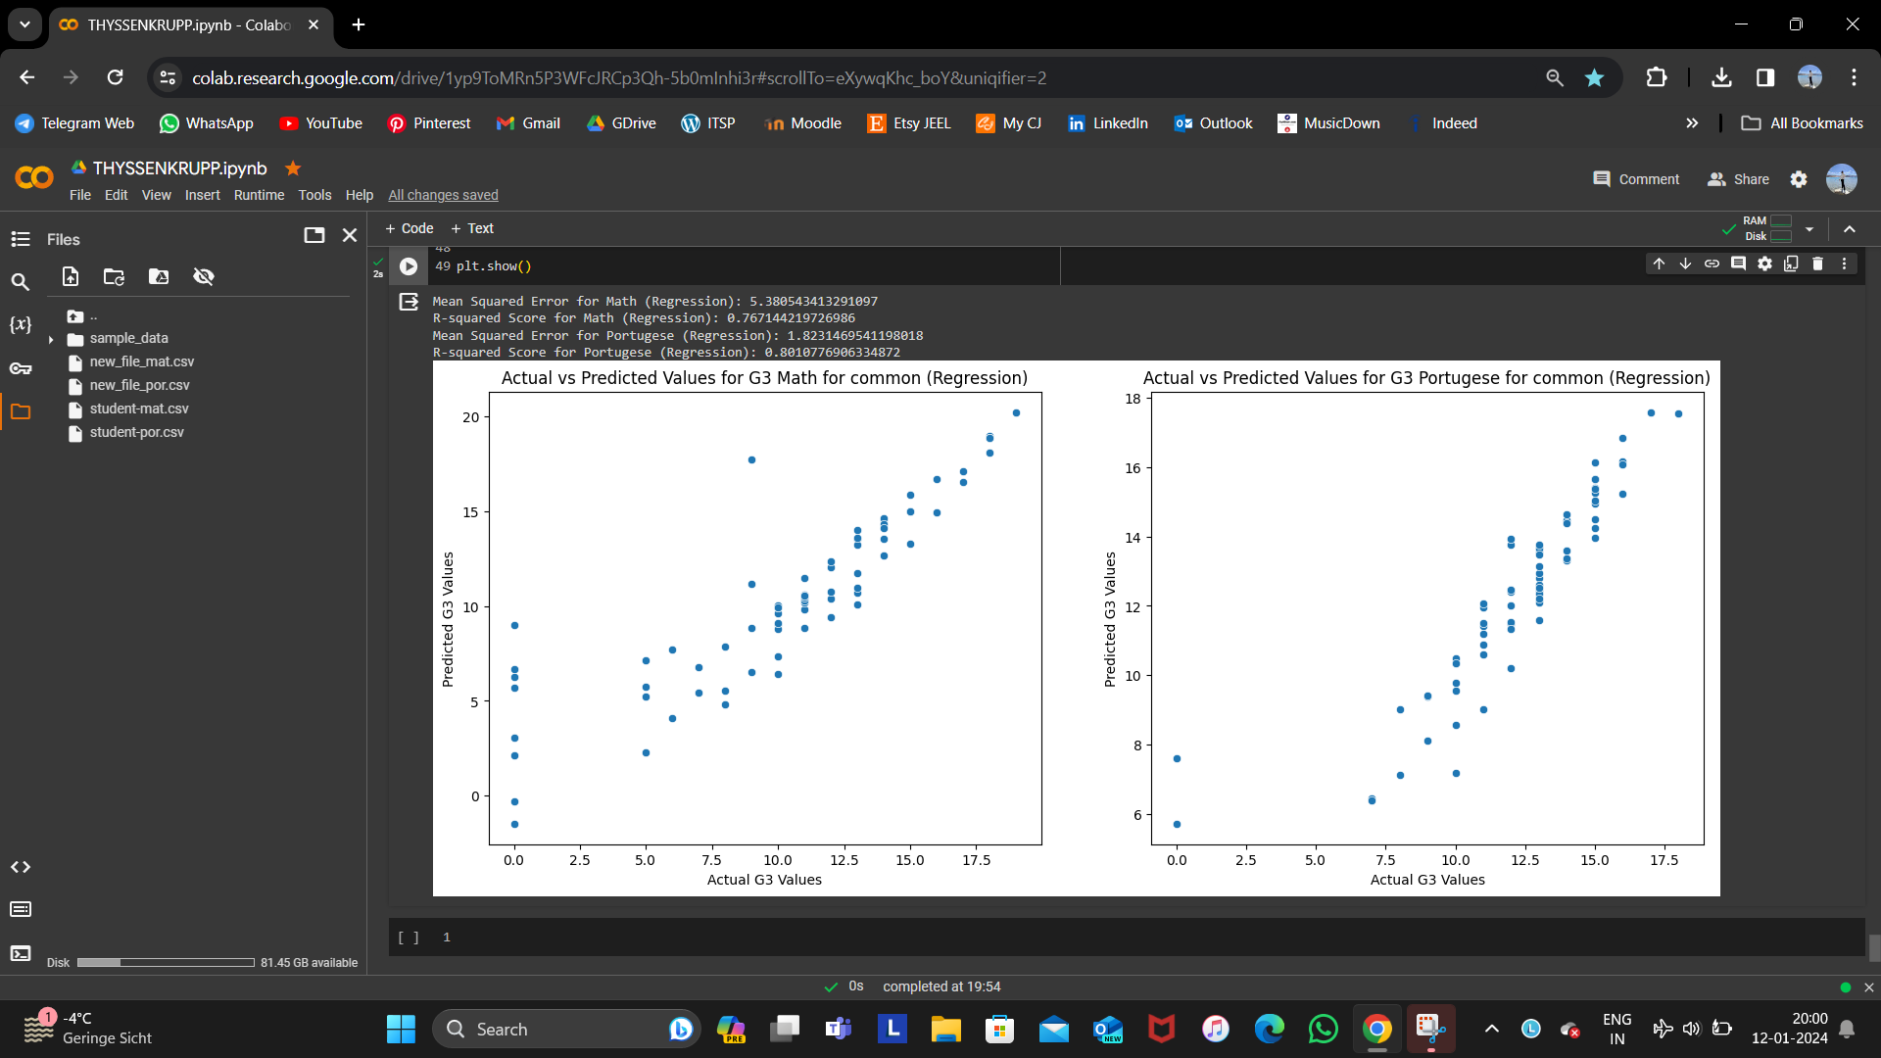
Result of Regression o inf G3 for both Mathematics and Portuguese Common dataset

Slide 16
The above process can be used for Everyday Energy Applications.
But, in that case the features will be different.
The features can be Source of Energy Production, Amount of Energy Produced, Amount of Energy Consumed, Capital needed for unit of Energy ($/kWh), Location etc.
For that scenario this process will look something like:
Importing existing Data
Getting info and description of the data.
Predicting outcome of the required column.

